Slide 1
Introduction to Robotics
Course no. 11 (again)
Andrei Dumitriu
andrei.dumitriu@fmi.unibuc.ro
Faculty of Mathematics and Computer Science
University of Bucharest

Slide 2
Today’s highlights
Q&A
Control Systems: open loop vs closed loop
PID
Line follower
Maze Solver
Attendance / Q&A

Slide 3
Open loop vs closed loop
In an open-loop control system, the control action from the controller is independent of the process variable. An example of this is a central heating boiler controlled only by a timer. The control action is the switching on or off of the boiler. The process variable is the building temperature. This controller operates the heating system for a constant time regardless of the temperature of the building. (Fig 1A)

Slide 4
Open loop vs closed loop
In a closed-loop control system, the control action from the controller is dependent on the desired and actual process variable. In the case of the boiler analogy, this would utilise a thermostat to monitor the building temperature, and feed back a signal to ensure the controller output maintains the building temperature close to that set on the thermostat.
A closed loop controller has a feedback loop which ensures the controller exerts a control action to control a process variable at the same value as the setpoint. For this reason, closed-loop controllers are also called feedback controllers. (Fig 1B)

Slide 5
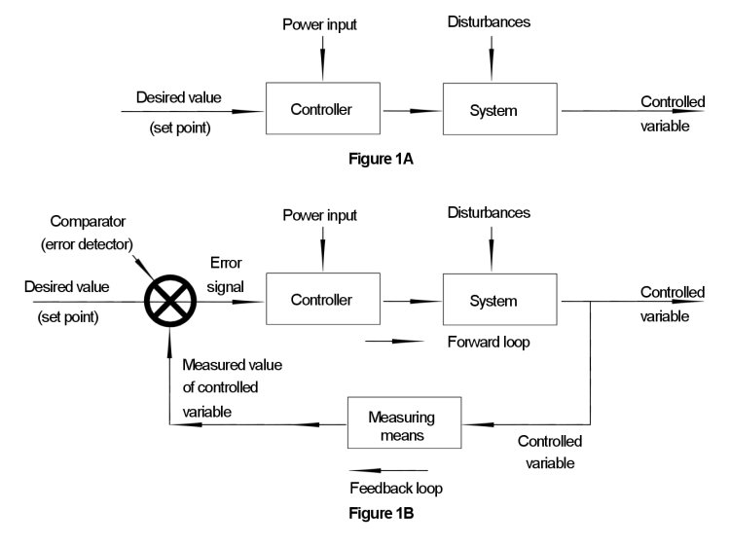
Open loop vs closed loop
Source: https://www.pesquality.com/blog/open-loop-and-closed-loop-systems

Slide 6
PID Controller
A proportional–integral–derivative controller (PID controller or three-term controller) is a control loop mechanism employing feedback that is widely used in industrial control systems and a variety of other applications requiring continuously modulated control. A PID controller continuously calculates an error value e(t) as the difference between a desired setpoint (SP) and a measured process variable (PV) and applies a correction based on proportional, integral, and derivative terms (denoted P, I, and D respectively), hence the name. Why P, I and D? What does each represent, in practice?

Slide 7
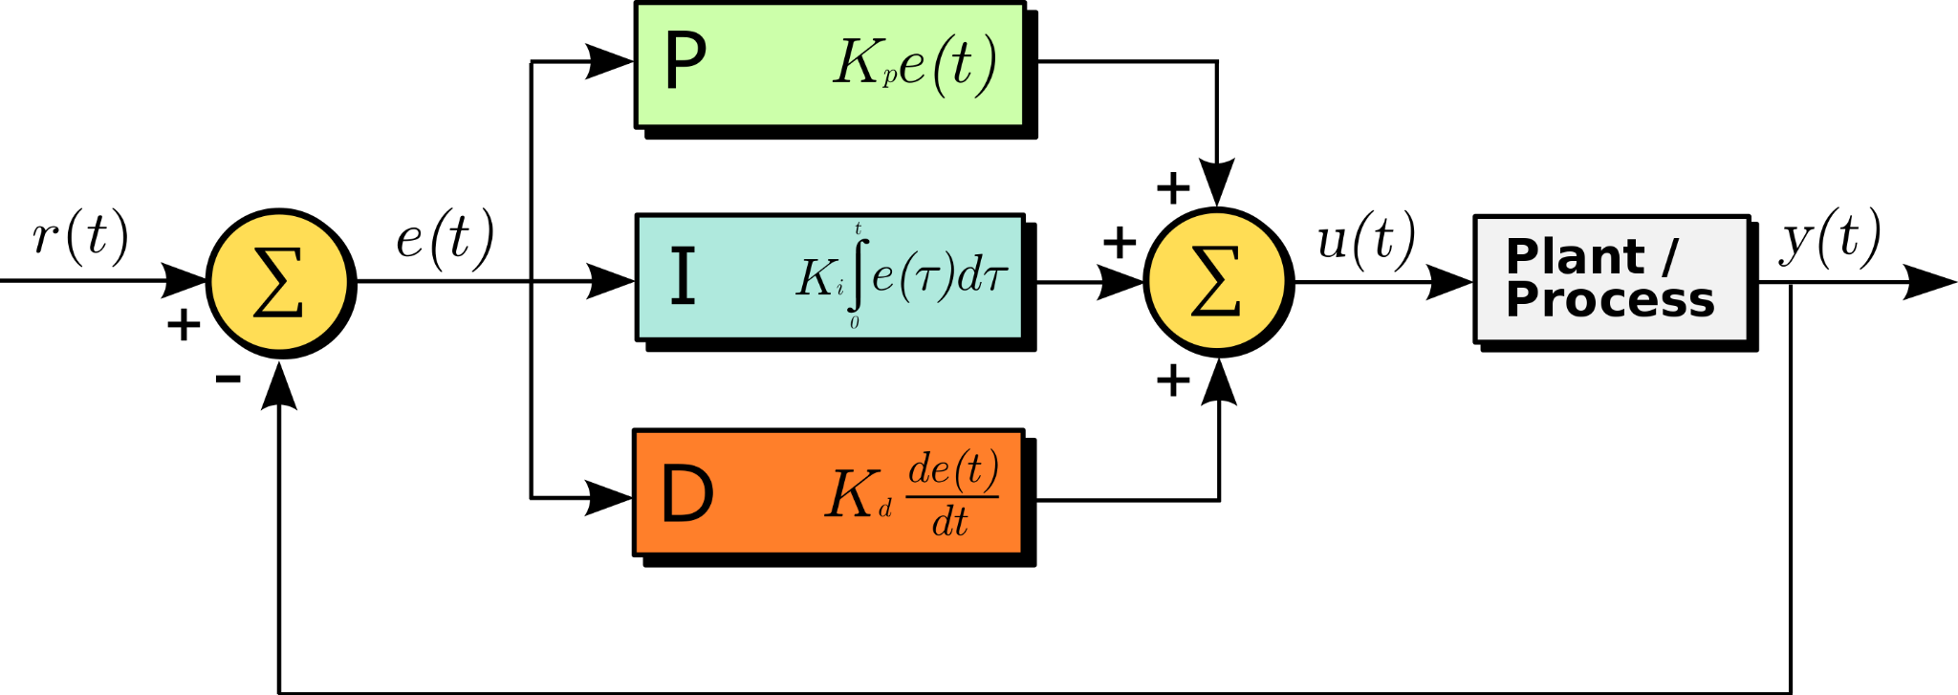
PID Controller
A plant in control theory is the combination of process and actuator.

Slide 8
PID Controller
The block diagram shows the principles of how these terms are generated and applied. It shows a PID controller, which continuously calculates an error value e(t)
as the difference between a desired setpoint SP and a measured process variable PV e(t) = r(t) - y(t)
Our goal is to minimize the error term.
A plant in control theory is the combination of process and actuator. You will find it as either Plant, Process or System.

Slide 9
PID Controller
Proportional Integral Derivative Each of these terms describes how the error term is treated. In proportional, the error term is multiplied by a constant Kp. In integral, the error term is integrated and multiplied by a constant Ki. In derivative, the error term is differentiated and multiplied by Kd. The terms Kp, Ki and Kd are called gains and you will be playing with them along the way. By changing these values you are adjusting how sensitive the system is to each of these different paths.
A plant in control theory is the combination of process and actuator. You will find it as either Plant, Process or System.

Slide 10
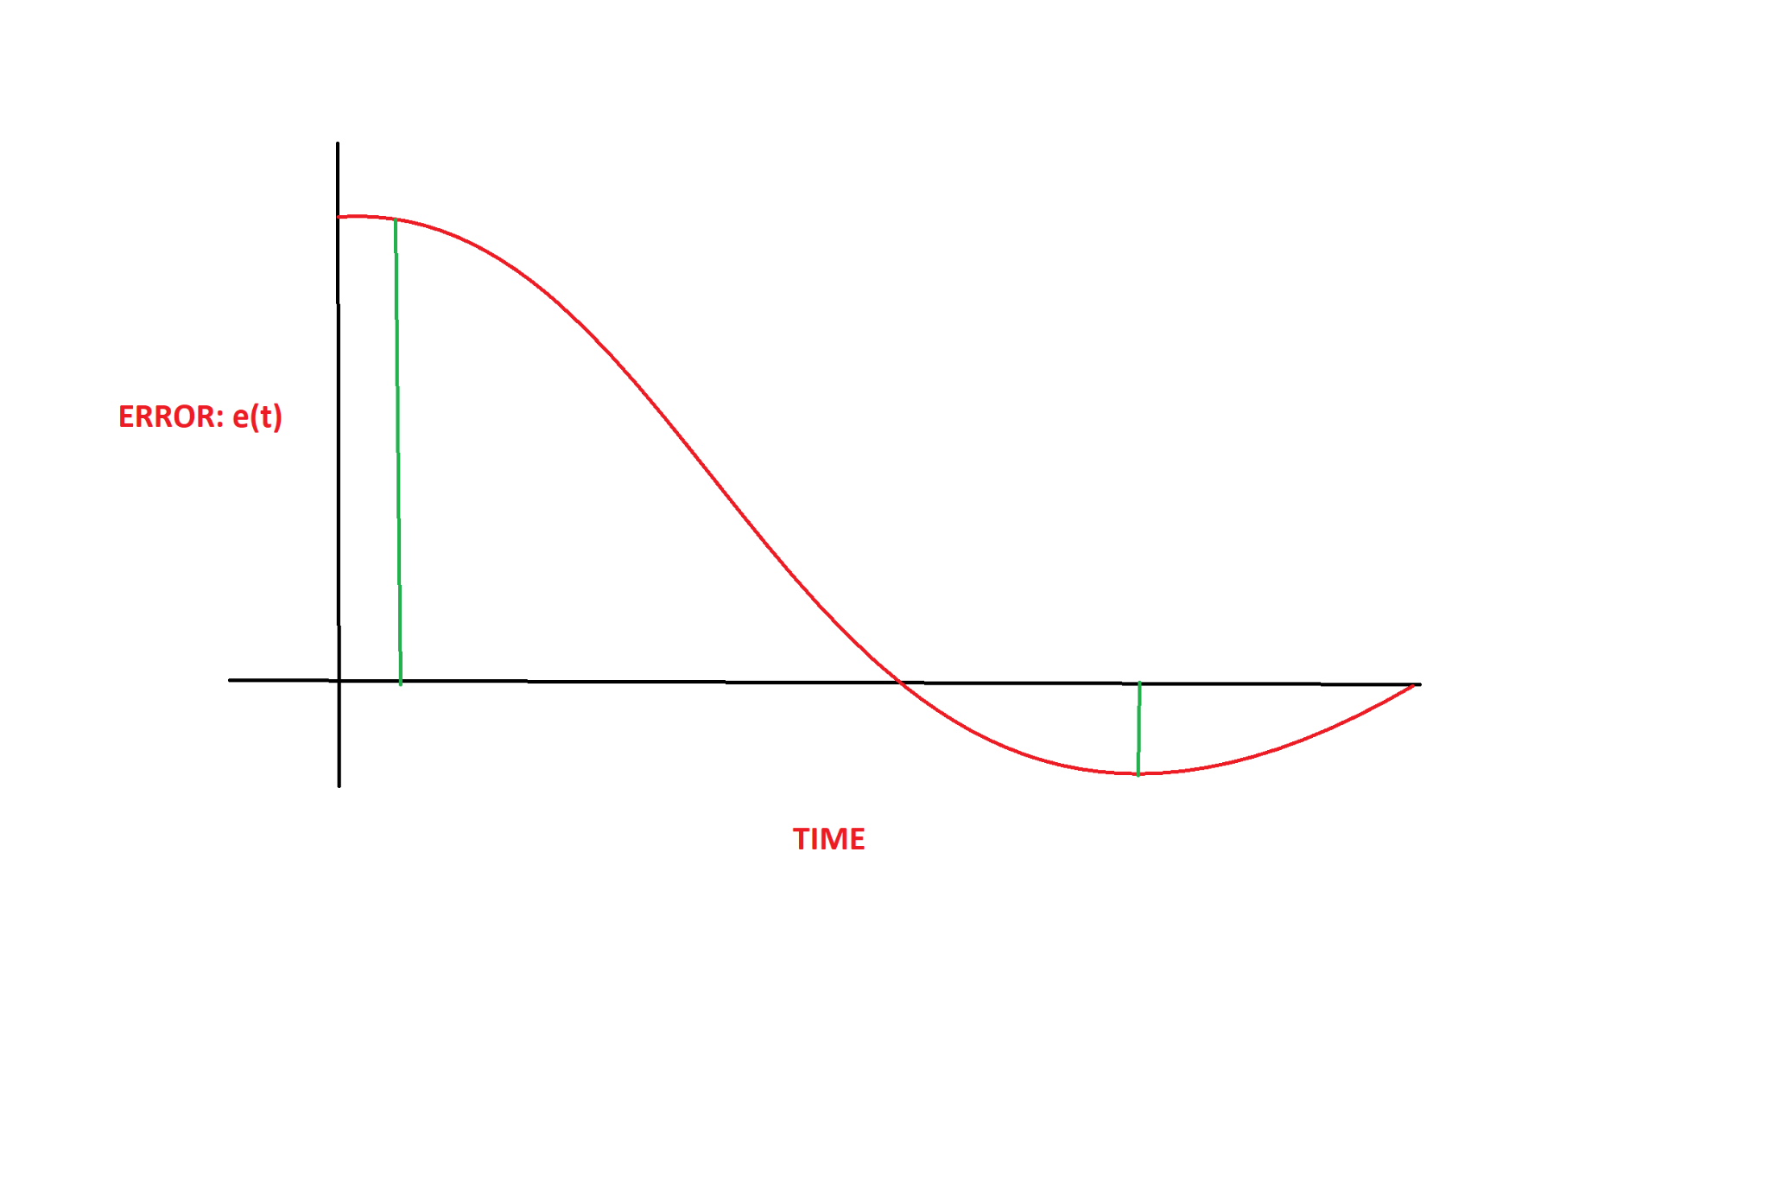
PID Controller
Kp *

Slide 11
PID Controller
Kp *
Proportional: it’s basically the error. When the error is positive, the output is positive. When the error is negative, the output is negative.

Slide 12
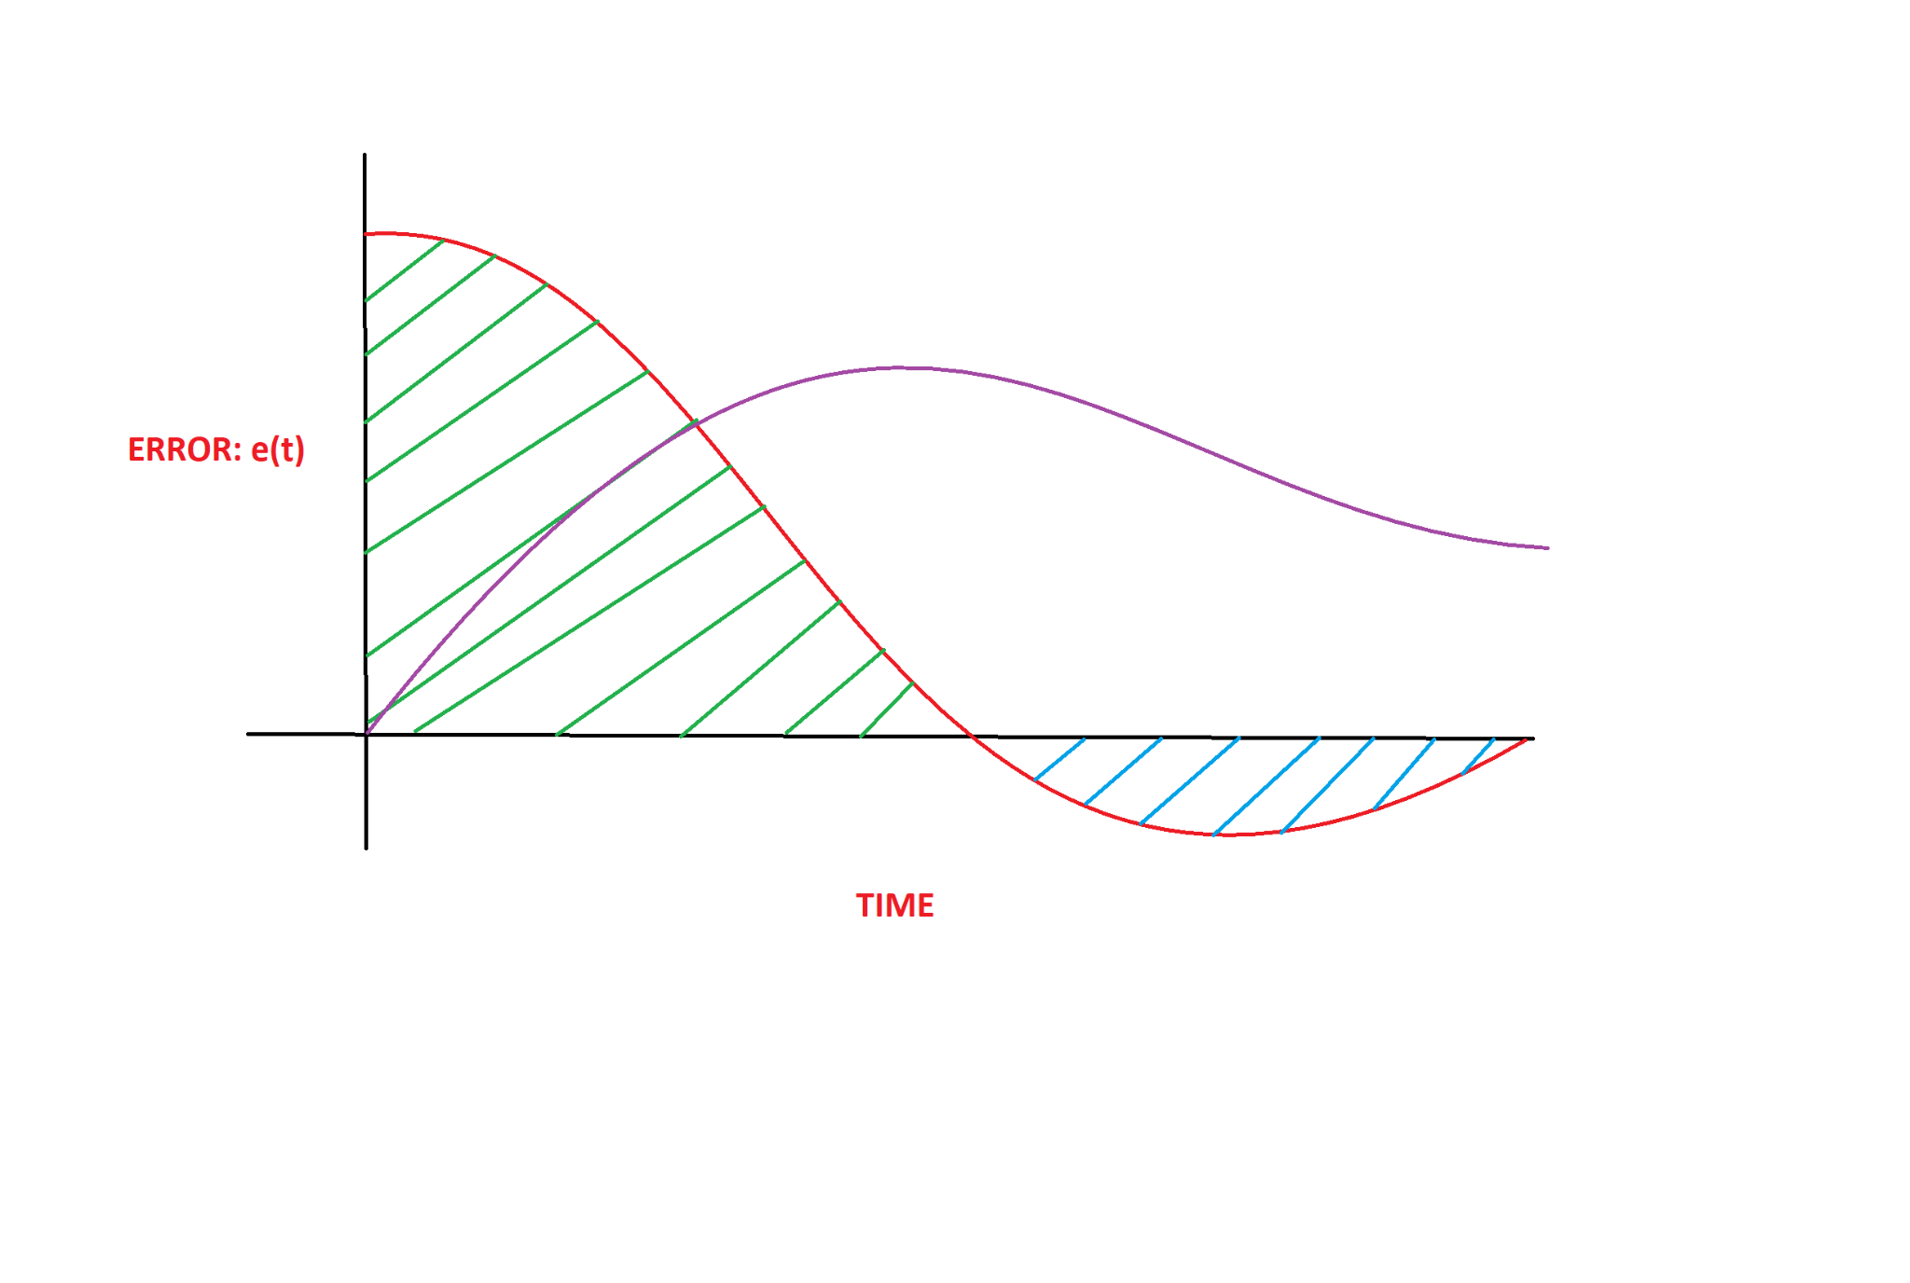
PID Controller
Kp *
+ Ki *
Proportional: it’s basically the error. When the error is positive, the output is positive. When the error is negative, the output is negative.

Slide 13
PID Controller
Kp *
+ Ki *
Proportional: it’s basically the error. When the error is positive, the output is positive. When the error is negative, the output is negative.
Integral: as the error moves over time, the integral will continuously summ it up. The integral is the area under the curve.

Slide 14
PID Controller
Kp *
+ Ki *
Proportional: it’s basically the error. When the error is positive, the output is positive. When the error is negative, the output is negative.
Integral: as the error moves over time, the integral will continuously summ it up. The integral is the area under the curve. It is used to remove the constant errors in the system, since no matter how small the constant error, eventually the summation of that error will be significant enough to adjust the controller output.

Slide 15
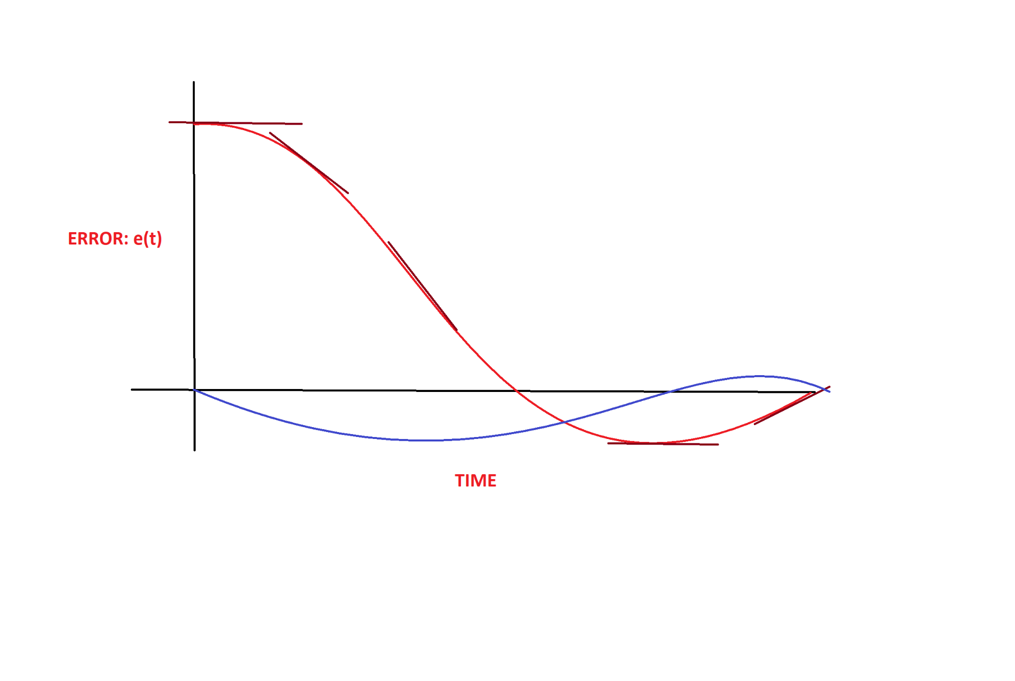
PID Controller
Kp *
+ Ki *
+ Kd *
Proportional: it’s basically the error. When the error is positive, the output is positive. When the error is negative, the output is negative.
Integral: as the error moves over time, the integral will continuously summ it up. The integral is the area under the curve. It is used to remove the constant errors in the system, since no matter how small the constant error, eventually the summation of that error will be significant enough to adjust the controller output.

Slide 16
PID Controller
Kp *
+ Ki *
+ Kd *
Proportional: it’s basically the error. When the error is positive, the output is positive. When the error is negative, the output is negative.
Integral: as the error moves over time, the integral will continuously summ it up. The integral is the area under the curve. It is used to remove the constant errors in the system, since no matter how small the constant error, eventually the summation of that error will be significant enough to adjust the controller output.
Derivative: it’s the rate of change of the error that contributes to the output signal. When the change is moving slowly, the derivative value is small. When it changes fast, the value is large.

Slide 17
PID Controller
Kp *
+ Ki *
+ Kd *
Proportional: it’s basically the error. When the error is positive, the output is positive. When the error is negative, the output is negative.
Integral: as the error moves over time, the integral will continuously summ it up. The integral is the area under the curve. It is used to remove the constant errors in the system, since no matter how small the constant error, eventually the summation of that error will be significant enough to adjust the controller output.
Derivative: it’s the rate of change of the error that contributes to the output signal. When the change is moving slowly, the derivative value is small. When it changes fast, the value is large.
It is used in smoothing (or cranking up) the system response.

Slide 18
PID Controller - how would you program it?
Kp *
+ Ki *
+ Kd *

Slide 19
PID Controller
Kp *
+ Ki *
+ Kd *
Keep in mind that you can use either a PI or PD controller, it doesn’t have to be the entire PID. This simplifies the approach and works well in certain systems. Learn to recognize the need. Understand the dynamics of the system!

Slide 20
PID Controller Examples
Keep in mind that you can use either a PI or PD controller, it doesn’t have to be the entire PID. This simplifies the approach and works well in certain systems. Learn to recognize the need.
Look and discuss the 3 examples in this video:
https://www.youtube.com/watch?v=XfAt6hNV8XM
Also, the same user explains the PID controller.
https://www.youtube.com/watch?v=UR0hOmjaHp0
https://www.youtube.com/watch?v=4Y7zG48uHRo

Slide 21
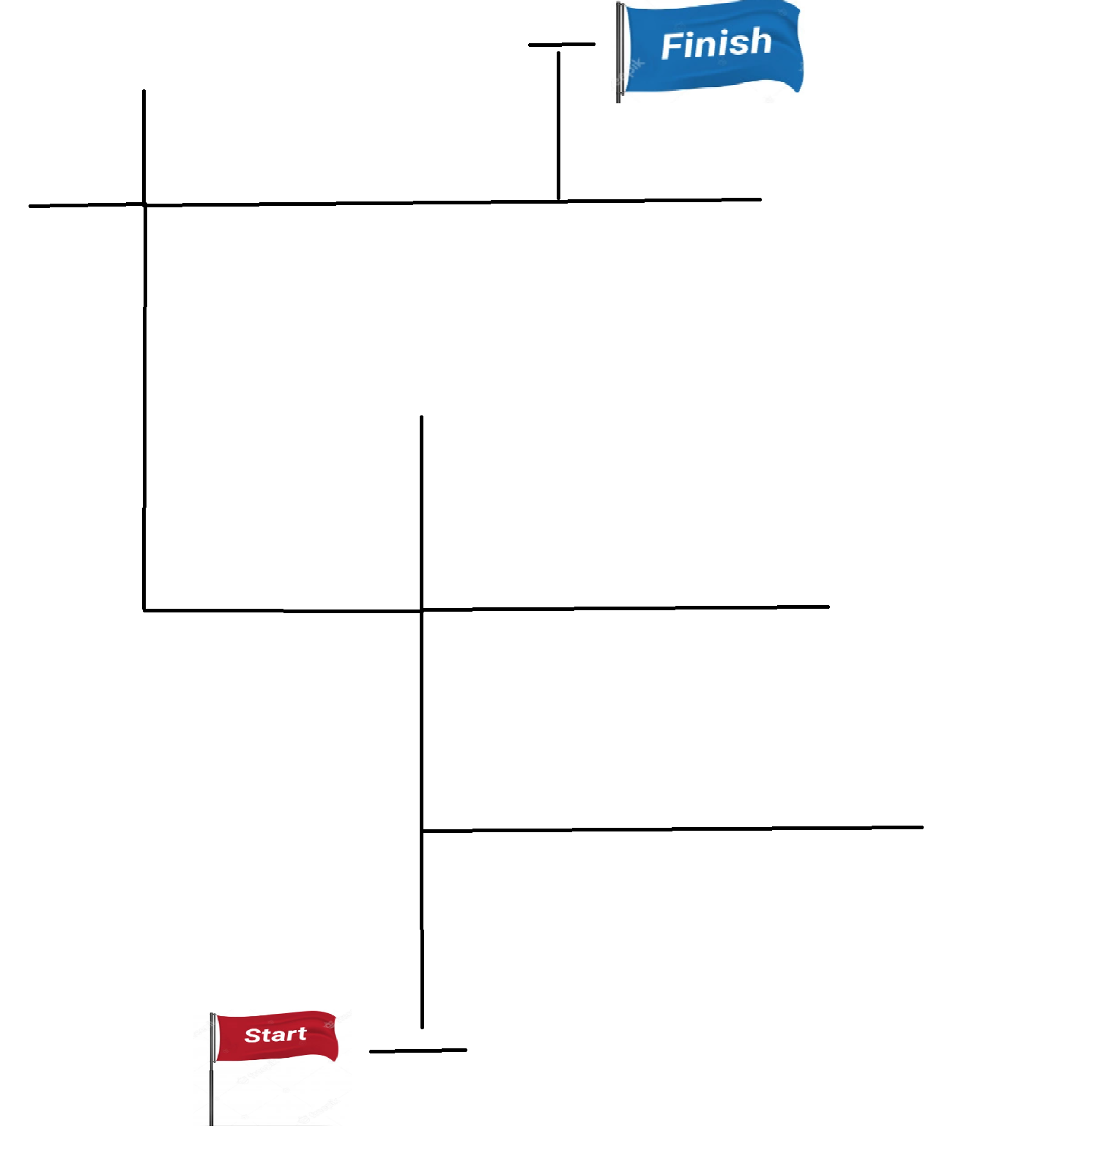
Maze solver

Slide 22
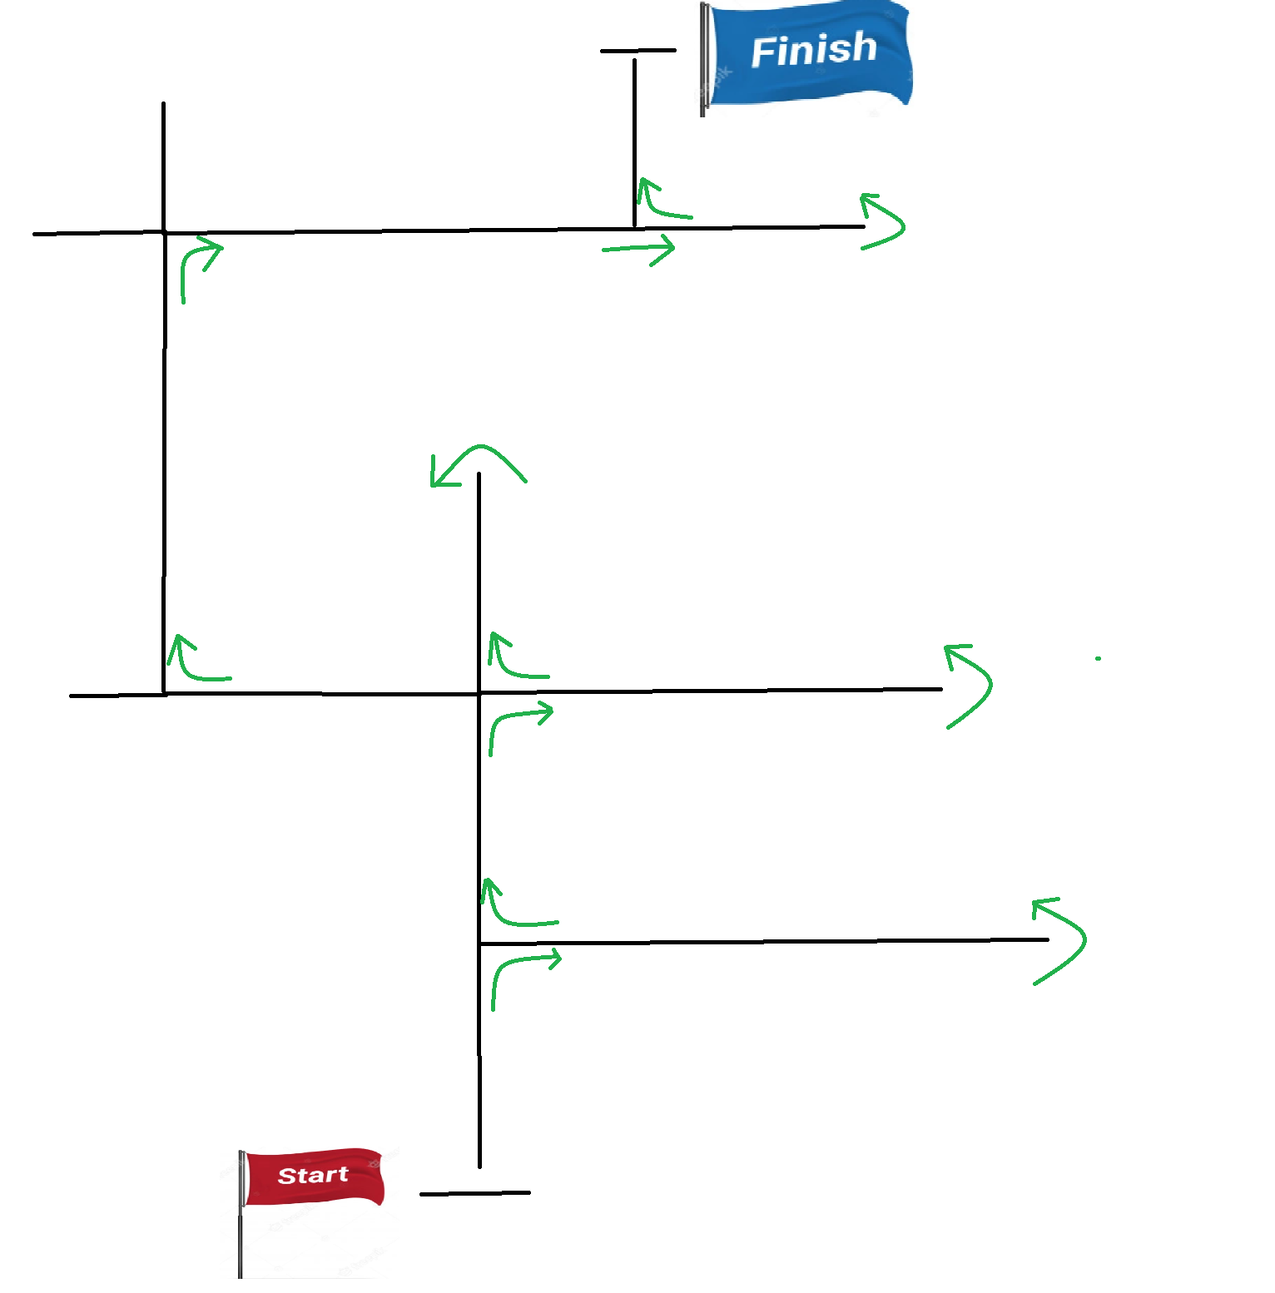
Maze solver - right hand rule

Slide 23
Attendance check

Slide 24
Vote: cand facem concursul?

